Slide 1
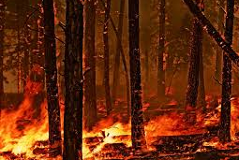
Utilization of Cellular Automata to Simulate Forest Fires
Notes:
Enjoyed the cellular automata portion of the class wanted to expand on it and explore some of the direct applications

Slide 2
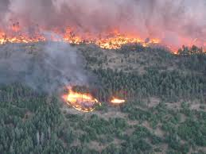
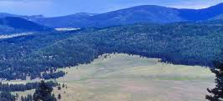
Forest Fire Simulations
Forest fires are a common occurrence
in the United States, on average from
2005-2014 there were 18,995 fires,
burning a total of 713,063 acres each year
Simulation Strategies:
Differential equation based models
Wavelet propagation algorithms
Cellular automata simulations
Notes:
Valles caldera – las conchas fire ??? – as our inspiration for this project / the forest and plain interface / scorched 30,000 acres of the preserve
This is of interest to many organizations including forest service and BLM USGS, for management as well as mitigation of damage to human inhabited areas

Slide 3
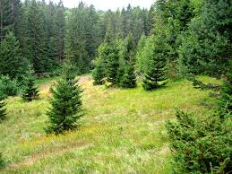
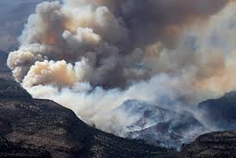
Parameters of Interest
Vegetation Regime
Forest
Plain
50/50 Combination
Wind Speed
None
Low
Medium
High

Slide 4
Our Cellular Automata Structure
40x40 space
Each cell updated with respect to 8 neighbors
For each neighbor currently burning there is an increased chance of ignition
Tradeoff in ease of ignition and fuel value for our two cell types
Each cell can be in one of three states : unburned, burning and burned
Vegetation Cell Type | Fuel Value (Burning Time in Iterations) | Probability of Catching Fire For Each Burning Neighbor
Forest | 5 | 7%
Plain | 3 | 10%
Notes:
These tradeoffs are present in the literature and could be easily adjusted for a specific terrain
Cell to be Updated

Slide 5
Wind
Cell Could Ignite with Wind
Wind increases the neighborhood by 1 cell in the direction of the wind
Wind decreases probability of ignition in the opposite direction
Wind Direction
Cell to Update
Reduced probability of ignition with wind

Slide 6
Simulation Examples

Slide 7
Preliminary Results
Above a certain threshold burning time may be more important than ease of ignition in total fire success
High wind may inhibit fire success if it forces the fire towards a barrier (in this case the edge of our cellular automata)

Slide 8
Future Analyses
Sensitivity of the fire behavior and success to each of our probability parameters
Wind has the ability to change direction and speed (within one level)
Addition of unburnable “fireline trench”

Slide 9
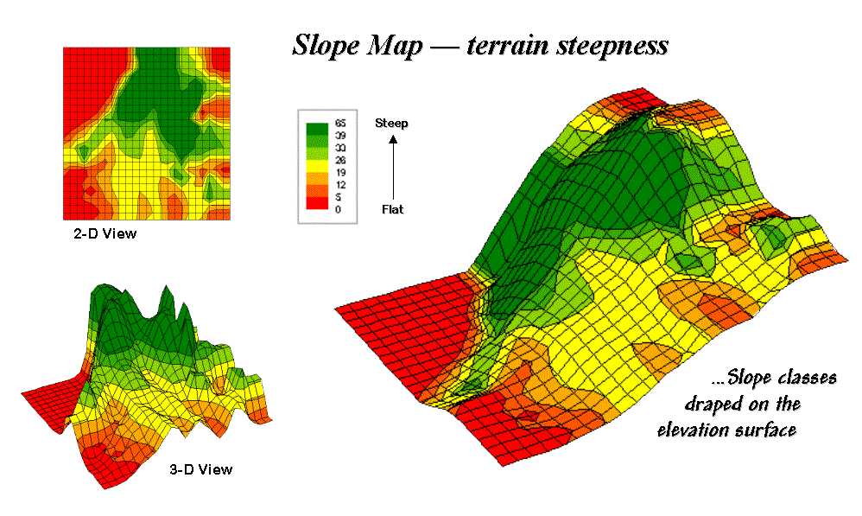
Other Areas of Interest
Effect of increasing the probability of wind direction changing
Modeling a specific vegetation interface
Addition of elevation / slope

Slide 10
References
Alexandridis, a., D. Vakalis, C. I. Siettos, and G. V. Bafas. 2008. A cellular automata model for forest fire spread prediction: The case of the wildfire that swept through Spetses Island in 1990. Applied Mathematics and Computation 204:191–201.
Almeida, R. M., and E. E. N. Macau. 2011. Stochastic cellular automata model for wildland fire spread dynamics. Journal of Physics: Conference Series 285:012038.
Berjak, S. G., and J. W. Hearne. 2002. An improved cellular automaton model for simulating fire in a spatially heterogeneous Savanna system. Ecological Modelling 148:133–151.
Hernández Encinas, L., S. Hoya White, a. Martín del Rey, and G. Rodríguez Sánchez. 2007. Modelling forest fire spread using hexagonal cellular automata. Applied Mathematical Modelling 31:1213–1227.
Sullivan, A. L. 2009. Wildland surface fire spread modelling, 1990–2007. 3: Simulation and mathematical analogue models. International Journal of Wildland Fire 18:387.
Yassemi, S., S. Dragićević, and M. Schmidt. 2008. Design and implementation of an integrated GIS-based cellular automata model to characterize forest fire behaviour. Ecological Modelling 210:71–84.

